Slide 1
Weekly Report
Prof. Huang & Shuo Zhang

Slide 2
Paper Reading
Unsupervised Anomaly Detection in Multivariate Spatio-Temporal Datasets Using Deep Learning, Yildiz Karadayi, AALTD(ECML/PKDD Workshop on Advanced Analytics and Learning on Temporal Data), 2019

Slide 3
Introduction
Generally, unsupervised methods can be used for either noise removal or anomaly detection, and supervised methods are designed for application-specific anomaly detection. Unsupervised methods are often used in an exploratory setting, where the discovered outliers are provided to the analyst for further examination of their application-specific importance [2].

Slide 4
Introduction
In spatial or temporal data domains, attributes are partitioned into contextual and behavioral attributes.
They first apply spatial (or non-temporal) context to find spatial outliers using a distance based technique. Then, spatial outliers are compared with other spatial objects using temporal neighborhoods to detect if they are temporal outliers too. They

Slide 5
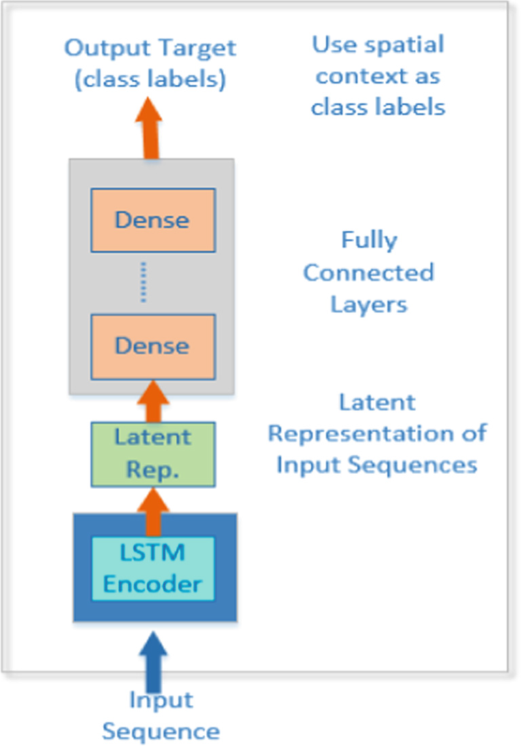
Proposed Model
LSTM Encoder to extract
temporal context and deep
neural network classifier to
learn the spatial context and
detect anomalies.

Slide 6
Proposed Model-LSTM
There is one encoder, but two decoder LSTMs:
One that decodes the representation generated by encoder into the input sequence
Another that decodes the same representation to predict the future multivariate time series.

Slide 7
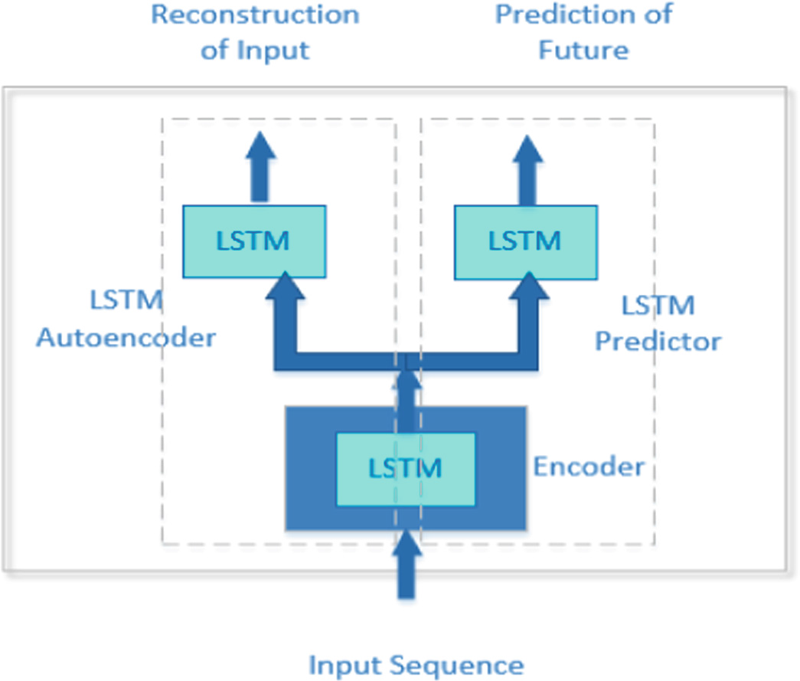
Proposed Model-LSTM

Slide 8
Proposed Model-DNN
The second component of proposed framework is deep neural network (DNN) based classifier which is responsible for extracting spatial context and doing classification of input data to identify anomalous input sequences within given data.

Slide 9
Experiment
Data in this dataset is divided into standard weeks, 7 day time frames, which begin on a Sunday and end on a Saturday.
Experiments were implemented in the Keras framework [21] using the Tensorflow backend. All deep learning models were trained using backpropagation algorithm and Rectified Linear Unit (ReLU) activation function on all layers, except the output layer of the classifier which softmax function was used. ADAM
The dataset used in this study is the historical San Francisco Police Department Incident Report, which covers from January 1, 2003 to May 15, 2018.

Slide 10
Experiment
LSTM Autoencoder models are used to detect multivariate anomalies based on reconstruction errors.
LSTM Future Predictor models are used to detect multivariate anomalies based on prediction errors.
Precision and recall were used to measure the accuracy of the classifier.

Slide 11
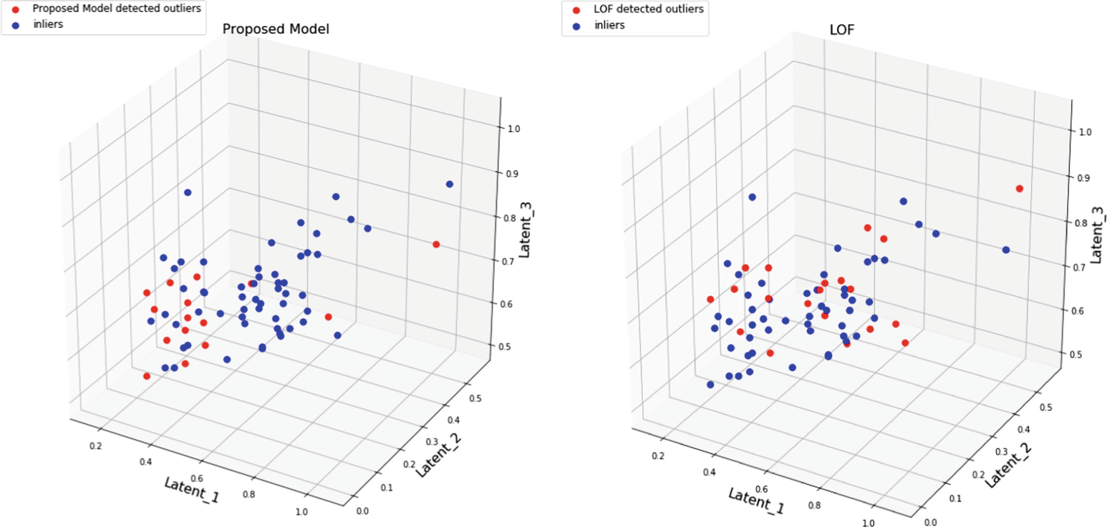
Result

Slide 12
Conclusion
The framework learn temporal and spatial contexts separately and uses those representations to identify spatio-temporal anomalies.
To further get improvements on spatial classifier, the model can be extended by applying convolutional neural network base spatial context extractor using finergrained neighborhood data.

Slide 13
Paper Reading
FuseAD: Unsupervised Anomaly Detection in Streaming Sensors Data by Fusing Statistical and Deep Learning Models Mohsin Munir Shoaib Ahmed Siddiqui Muhammad Ali Chattha Andreas Dengel Sheraz Ahmed, 2019, Sensor

Slide 14
Introduction
Type of anomaly: point anomaly, contextual anomaly, and collective anomaly.
Availability of labels: supervised, unsupervised, and semi-supervised.
Type of employed model: linear models, statistical models, probabilistic models, clustering-based, nearest-neighbors-based, density-based, deep-learning-based, etc.
Applications: fraud detection, surveillance, industrial damage detection, medical anomaly detection, and intrusion detection, etc.

Slide 15
Introduction
Generally, for streaming data, the anomaly detection methods consist of two modules, a value at the next timestamp is forecasted first, and then it is compared with the actual value to mark the data point as normal or anomalous.

Slide 16
Methodology
ARIMA and CNN forecasting models are building blocks of the proposed FuseAD and are combined in a way to get benefit from each other.

Slide 17

Methodology
In this formulation, instead of treating the CNN as a mapping from the input space X to the output space Y, we consider it to be a mapping from the input space X to an intermediate space Z. We then add an offset (the output of ARIMA) to transform it back to the output space Y.

Slide 18
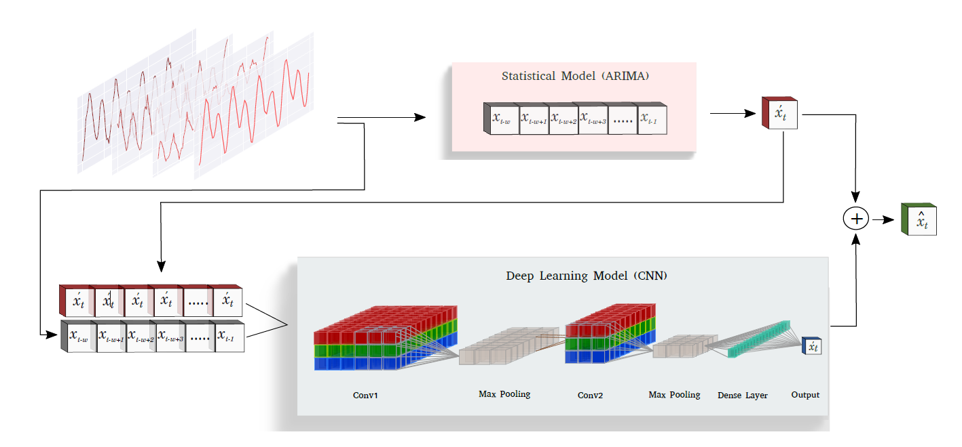
Methodology

Slide 19
Methodology
In this way, the output of CNN can be considered as a correction term for the output of the ARIMA model. In a case where the output of ARIMA is accurate, CNN can suppress its output in order to retain the prediction made by ARIMA.
On the other hand, when the prediction is significantly off, the network can generate large offsets in order to compensate for the error made by the ARIMA model.
In this way, the network itself can decide its reliance on the output of ARIMA during training to adapt its behavior so as to overcome its limitations.

Slide 20
Experiment
We have evaluated the proposed technique on two anomaly detection benchmarks that consist of real and synthetic streaming data:
YahooWebscope is an open-source time-series anomaly detection benchmark.
The Numenta Anomaly Benchmark (NAB) is an open-source streaming anomaly detection benchmark introduced by Numenta.

Slide 21
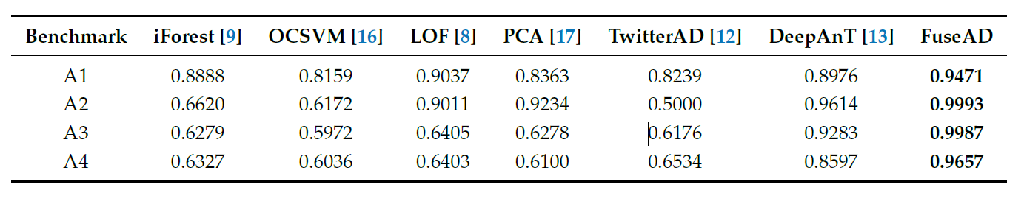
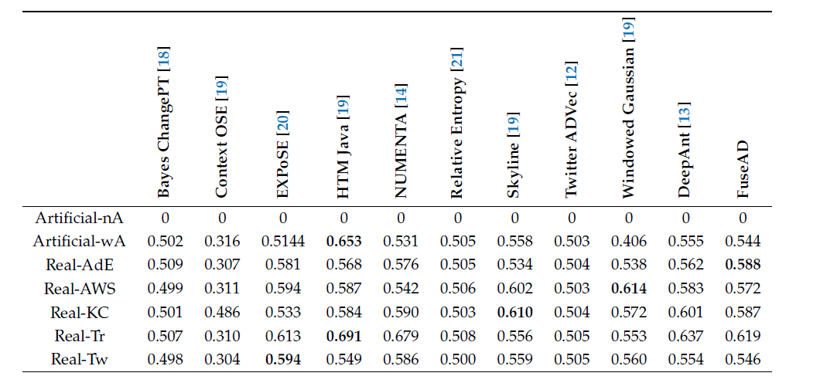
Result-Part1

Slide 22
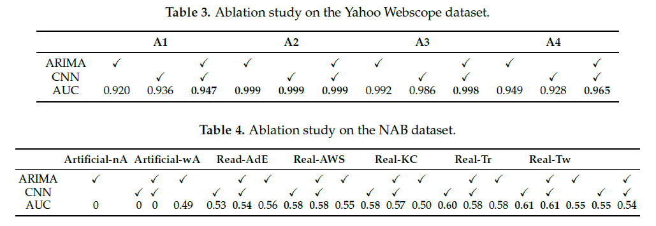
Result-Part2

Slide 23
Thank u !
@MICC

